Slide 2
Unit Objectives
Understand links and paths
Create an external link
Create an internal link
Insert a named anchor
Create internal links to named anchors
Create a Spry menu bar
Add menu bar items
Format a menu bar
Copy a menu bar to other pages
Create an image map
Manage website links

Slide 3
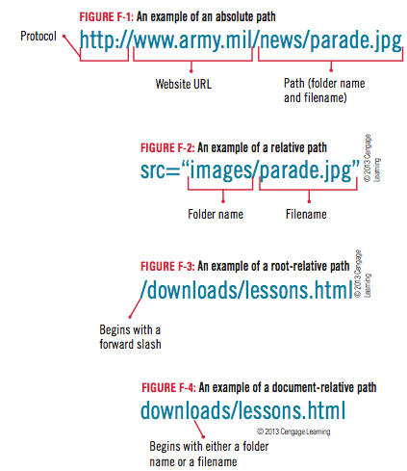
Understanding Links and Paths
Internal and external links
Absolute paths
Relative paths
Root-relative paths
Document-relative paths

Slide 4
Design Matters
To minimize errors, copy and paste the URL of the web page that you would like to include as an external link in your website
To be sure that your links will work with all systems, use lowercase letters for all URLs

Slide 5
Clues to Use
Creating an Effective Navigation Structure
It’s important that all text, buttons, and icons you use on a menu bar have a consistent look across all pages
If you use a complex menu bar, such as one that incorporates JavaScript or Flash, it’s a good idea to include plain text links in another location on the page for accessibility

Slide 6
Creating an External Link
Open The Striped Umbrella Web site; open dwf_1.html from the drive and folder of your Unit F Data Files
Save the file as activities.html in the striped_umbrella site root folder, overwriting the existing file but not updating links
Close dwf_1.html
Select the first broken image placeholder
Click the Browse for File button next to the Src text box in Property inspector
Select family_sunset.jpg
Click OK (Win) or Open (Mac) to save the image
Click to the right of the placeholder

Slide 7
Creating an External Link
Select the second broken image placeholder
Repeat step 3 to place two_dolphins.jpg on the page
Attach the su_styles.css file, then apply the body_text style to the paragraphs of text on the page
Apply the img_left_float rule to the first image and the img_right_float rule to the second image
Scroll to the bottom of the page, then select the text Blue Angels
Click the Link text box in the HTML Property inspector
Type http://www.blueangels.navy.mil
Then press [Tab]

Slide 8
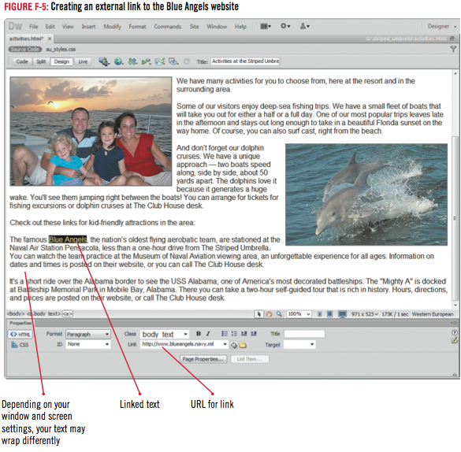
Creating an External Link
Click File on the Menu bar, click Save, click the Preview/debug in browser button, click Preview in [your browser], click Blue Angels on the web page, verify that the link works, then close your browser
Scroll to the bottom of the page if necessary, select the USS Alabama text in the last paragraph on the page, then repeat step 8 to create the link for the USS Alabama text, using the URL http://www.ussalabama.com

Slide 9
Design Matters
The Web Accessibility Initiative – Accessible Rich Internet Applications Suite
A resource for applying best practices when adding advanced user interface controls to a website
WAI-ARIA, at w3.org/WAI, provides guidelines and techniques for planning and implementing accessible content

Slide 10
Creating an Internal Link
Select fishing excursions in the third paragraph (see Figure F-6)
Click the Browse for File icon next to the Link text box in the HTML Property inspector
Make sure the Relative to box is set to Document; double-click fishing.html
Select dolphin cruises in the same sentence
Click the Browse for File icon in the Property inspector, then double-click cruises.html in the Select File dialog box
Save your work
Close the activities page

Slide 11
Design Matters
Linking to the home page
Every page in your website should include a link to the home page so a user who has become “lost” in your site can quickly go back to the starting point without relying on the Back button

Slide 12
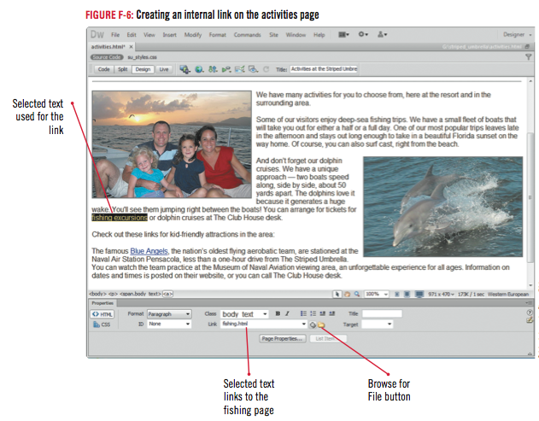
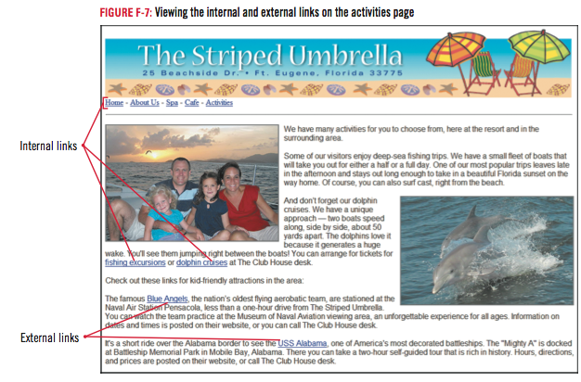
Creating an Internal Link

Slide 13
Inserting a Named Anchor
Open the spa.html page, click View on the Menu bar
Point to Visual Aids
Click Invisible Elements to select it
Click The Striped Umbrella banner
Then press the left arrow key
Click the Common category on the Insert Panel, if necessary
Click Named Anchor on the Insert panel, type top in the Anchor name box of the Named Anchor dialog box, then click OK

Slide 14
Inserting a Named Anchor
Click to place the insertion point to the left of the Massages heading above the first unordered list, click Named Anchor on the insert panel, type massages in the Anchor name text box, then click OK
Repeat step 5 to insert named anchors to the left of the Facials and body treatments list headings, using the following names: facials and body_treatments, deselect the text, then click the body_treatments named anchor to select it
Save your work

Slide 15
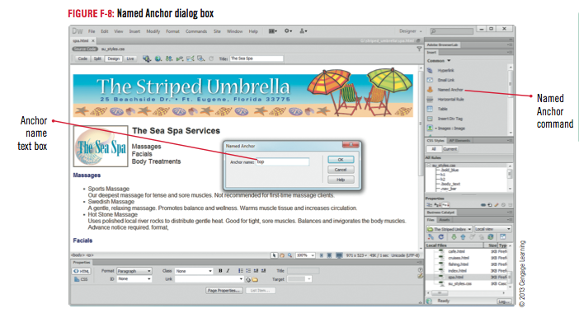
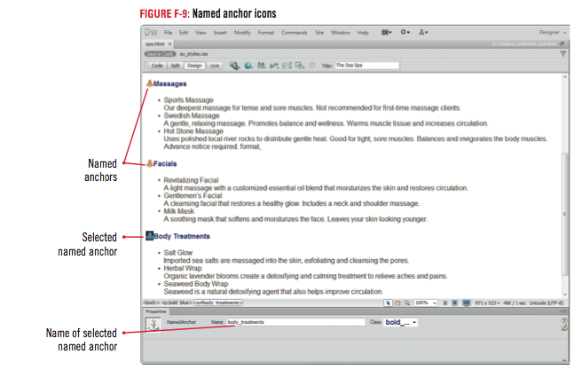
Inserting a Named Anchor

Slide 16
Creating Internal Links to Named Anchors
Select the Massages heading to the right of The Sea Spa logo (see Figure F-10)
Then click and drag the Point to File icon in the HTML Property inspector on top of the massages named anchor in front of the Massages heading
Repeat step 1 to create internal links for the Facials and Body Treatments headings
Select each heading next to the logo
Click and drag the Point to File icon to the named anchors

Slide 17
Creating Internal Links to Named Anchors
Click at the end of the last line on the page, press [Enter] (Win) or [return] (Mac), then type Return to top of page
Repeat step 1 again to link the Return to top of page text to the named anchor in front of the banner
Click anywhere in the Return to top of page text, wait for a few seconds until the Click Indicator to bring up the Code Navigator Icon appears, and then click it
Save your work, preview the spa page in your browser window, test each link, then close your browser

Slide 18
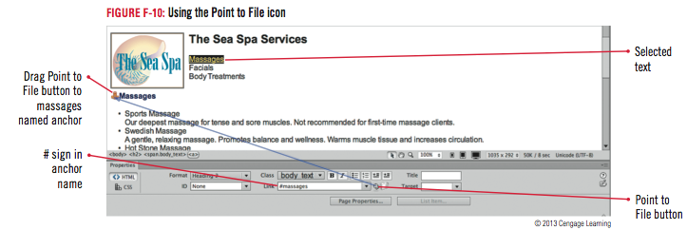
Creating Internal Links to Named Anchors

Slide 19
Clues to Use
Using the Code Navigator
The Code Navigator lists the CSS rule name linked to the page element
Along with the name of the style sheet that contains the rule
Pointing to the rule name will display the properties and values of the rule

Slide 20
Creating a Spry Menu Bar
Select the banner on the spa page, press the right arrow key, then press [Shift] [Enter] (Win) or [Shift] [return] (Mac)
Click the Insert panel list arrow on the Insert panel
Click the Spry category
Scroll down if necessary to click Spry Menu Bar
Click to select the Horizontal layout option button in the Spry Menu bar dialog box
Click OK
Select MenuBar1 in the Menu Bar text box on the Property inspector, then type MenuBar
Select Item 1 in the Text text box on the right side of the Property inspector
Type Home

Slide 21
Creating a Spry Menu Bar
Select Item 1.1
Click the Remove menu Item button
Click Remove Menu Item button two more times
Click the Browse for File icon next to the Link text box on the Property inspector
Double-click index.html in the site root folder, then compare your Property inspector to Figure F-15
Click to place the insertion point to the right of the menu bar
Enter a line break
Compare your screen to Figure F-16
Save your file, then click OK to close the Copy Dependent Files dialog box
Refresh the Files panel if necessary

Slide 22
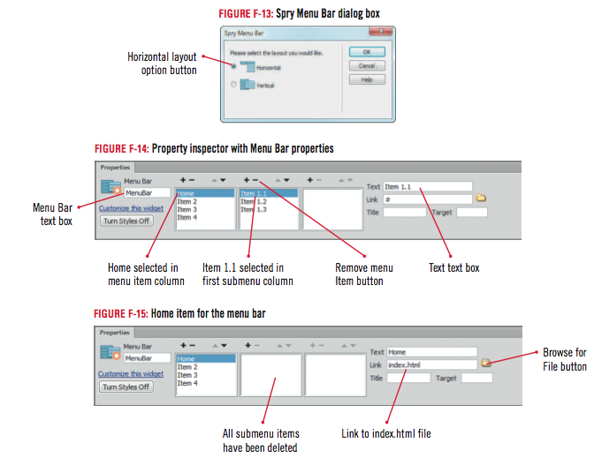
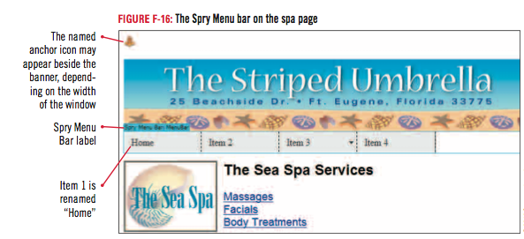
Creating a Spry Menu Bar

Slide 23
Clues to Use
Inserting a Fireworks Menu Bar
Create a menu bar in Fireworks
Import the menu bar into the Web page using Dreamweaver
Use the Insert, Image Objects, Fireworks.html command
Can also import rollover images and buttons created in Fireworks

Slide 24
Adding Menu Bar Items
Click the Spry Menu Bar: MenuBar tab if necessary, then click Item 2 in the Item menu column (first column) in the Property inspector, select Item 2 in the Text text box, then type About Us
Click the Browse button next to the Link text box, click about_us.html in the site root folder, then click OK
Repeat Steps 1 and 2 to rename Item 3 Sand Crab Cafe and link it to the cafe.html page in the site root folder
Delete each submenu item under the Sand Crab Cafe menu item
Click OK to close the warning box confirming the removal of each of the submenus

Slide 25
Adding Menu Bar Items
Repeat Steps 1 and 2 to rename Item 4 The Sea Spa and link it to the spa.html page in the local site root folder
Click the Add menu item button above the Item menu column (second column)
Select Untitled Item, in the Text text box type Activities, then link it to the activities.html page
Click the Add Menu Item button above the first submenu column (second column)
Select Untitled Item
Type Cruises in the Text text box
Then link it to the cruises.html page

Slide 26
Adding Menu Bar Items
Repeat Step 7 to add another submenu item named Fishing
Link it to the fishing.html page
Save your work
Compare your screen to Figure F-17
Create a new tag rule in the su_styles.css file to modify the <img> tag, then set the block vertical-align to bottom
Click the Switch Design View to Live View button on the Document toolbar, view the menu bar, then compare your screen to Figure F-18
Click the Switch Design View to Live View button again

Slide 27
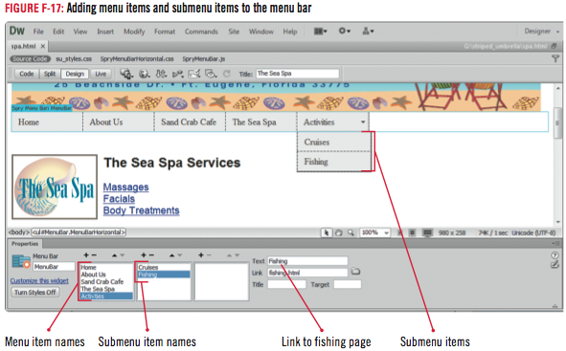
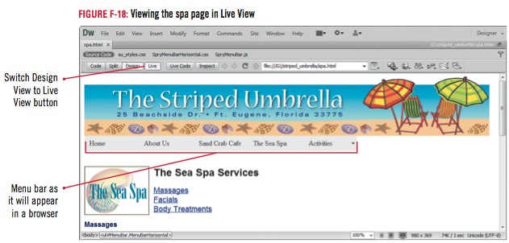
Adding Menu Bar Items

Slide 28
Clues to Use
Viewing your page in Live View
Gives more accurate picture of what page will look like displayed in a browser
Interactive elements active and functioning
Use Switch Design View to Live View button to enable

Slide 29
Formatting a Menu Bar
Click the plus sign (Win) or right pointing arrow (Mac) next to SpryMenuBarHorizonal.css in the CSS Styles panel if necessary
Select the rule ul.MenuBarHorizontal
Click the Edit Rule button on the CSS styles panel
Click Type in the Category list, click the Font-family list arrow
Click Arial, Helvetica, sansserif
Click the Font-size list arrow, click 14
Click the Font-size unit of measure list arrow, click px, compare your screen to Figure F-19
Then click OK

Slide 30
Formatting a Menu Bar
Select the ul.MenuBarHorizontal li rule in the CSS Styles panel
Click the Edit Rule button
Click Box in the Category list
Click the Width text box, type 190
Click the Width unit of measure list arrow , click px
Click in the Height text box, type 25
Compare your screen to Figure F-20
Click Block in the Category list, click the Text-align text box arrow, select center, then click OK

Slide 31
Formatting a Menu Bar
Click ul.MenuBarHorizontal a in the CSS Styles panel
Click the Edit Rule button
Click Type in the Category list, type #FFF in the Color text box
Click Background in the Category list
Type #09C in the Background-color text box, then click OK
Click ul.MenuBarHorizontal a.MenuBarItemHover, ul.MenuBarHorizontal a.MenuBarItemSubmenuHover, ul.MenuBarHorizontal a.MenuBarSubmenuVisible in theCSS Styles panel, then click the Edit Rule button

Slide 32
Formatting a Menu Bar
Click Type in the Category list, type #630 in the Color text box, click Background in the Category list, type #FC9 in the Background-color text box, then click OK
Click File on the Menu bar
Click Save All
Preview your page in the browser
Compare your screen to Figure F-21
Test each link to ensure that each works correctly
Close the browser

Slide 33
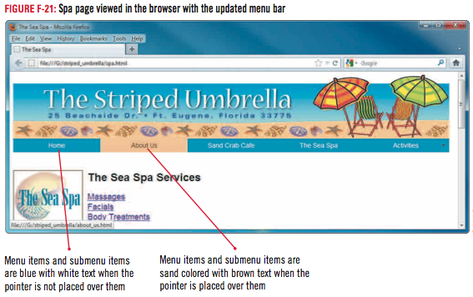
Formatting a Menu Bar

Slide 34
Copying a Menu Bar to Other Pages
Click the Spry Menu Bar:MenuBar tab above the top left corner of the menu bar
Click Edit on the Menu bar
Then click Copy
Double-click activities.html on the Files panel
Select the original menu bar on the page, click Edit on the Menu bar
Click Paste, click to the right of the menu bar, add a line break, delete the horizontal rule, compare your screen to Figure F-23
Then save the page

Slide 35
Copying a Menu Bar to Other Pages
Open the index page, delete the current menu bar, delete any <p> tags around the banner
Click the banner to select it, press the right arrow key
Paste the Spry menu bar on the page, delete the horizontal rule, then insert a line break after the menu bar
Open the about_us page
Replace the current menu bar with the new menu bar
Add a line break
Delete the horizontal rule
Apply the body_text rule to the heading “Welcome guests!”

Slide 36
Copying a Menu Bar to Other Pages
Click File on the Menu bar, click Save All, then preview each page in the browser
Hold the pointer over the Activities link
Close the browser
Close all open pages except the about_us page

Slide 37
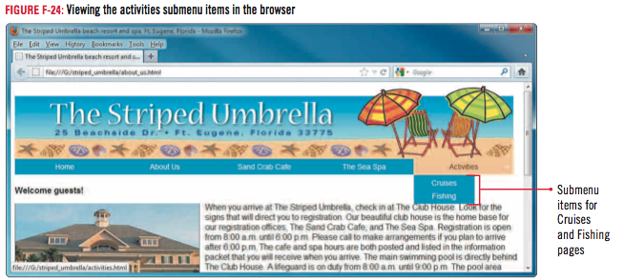
Copying a Menu Bar to Other Pages

Slide 38
Creating an Image Map
Click The Striped Umbrella banner on the about_us page to select it
Then double-click a blank area on the right side of the Property inspector to expand it, if necessary
Click the Rectangle Hotspot Tool button on the Property inspector
Drag to create a rectangle that encompasses The Striped Umbrella name on the banner, release the mouse button
Click OK to close the Dreamweaver dialog box, then compare your screen to Figure F-25
Drag the Point to File icon next to the Link text box in the Property inspector to index.html in the Files panel

Slide 39
Creating an Image Map
Select Map in the Map text box in the Property inspector, then type home
Click the Target List arrow in the Property Inspector, then click _self
Type Link to home page in the Alt text box in the Property inspector
Switch to Code view, locate the <br> tag that has been added below the ending </map> tag, then delete it
Place the insertion point right before the closing image tag for the banner, then type style=“border:0”
Return to Design view, save your work, preview the page in your browser window, test the link on the image map, then close the browser

Slide 40
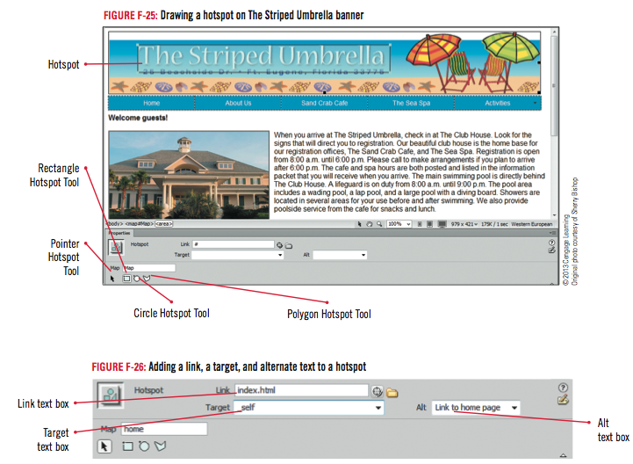
Creating an Image Map

Slide 41
Clues to Use
Setting targets for links
Set by clicking the Target list arrow in the HTML Property inspector
Select desired target
Four options for how new window will open when link is clicked
_blank, _parent, _self, _top

Slide 42
Design Matters
Creating and modifying hotspots
Rectangle
Circle
Polygon
Hotspots can easily be changed and rearranged

Slide 43
Managing Web Site Links
Click Site on the Menu bar, then click Check Links Sitewide
Click the Show list arrow in the Link Checker panel, then click External Links
Click the Show list arrow, then click Orphaned Files
Close the Results Tab group, click the Assets tab on the Files tab group, then click the URLs button on the Assets panel
Close the about_us page, then Exit (Win) or Quit (Mac) Dreamweaver

Slide 44
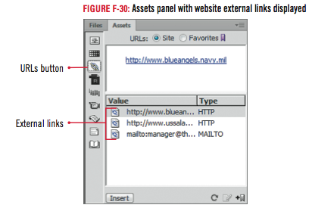
Managing Web Site Links

Slide 45
Unit Summary
Understand links and paths
Create an external link
Create an internal link
Insert a named anchor
Create internal links to named anchors
Create a Spry menu bar
Add menu bar items
Format a menu bar
Copy a menu bar to other pages
Create an image map
Manage Web site links

